Slide 1




Introduction to Deep Learning Architectures
This presentation delves into the fascinating world of deep learning architectures, exploring the capabilities and applications of Transformers, Generative Adversarial Networks (GANs), Variational Autoencoders (VAEs), and Long Short-Term Memory (LSTM) networks.
by Juvenile teachers

Slide 2

Generative Adversarial Networks (GANs)
GANs are a powerful deep learning technique for generating realistic data. They comprise two neural networks: a generator and a discriminator, competing to improve their performance.
1
Generator
The generator network creates synthetic data that mimics the distribution of real data.
2
Discriminator
The discriminator network learns to distinguish between real and generated data.
3
Competition
The generator aims to fool the discriminator, while the discriminator seeks to accurately classify data.

Slide 3
Variational Autoencoders (VAEs)
VAEs are generative models that use a probabilistic approach to learn the underlying distribution of data. They consist of an encoder and a decoder.
Encoder
Decoder
Latent Space
The encoder maps input data to a lower-dimensional latent space, capturing the key features.
The decoder reconstructs the original data from the latent representation.
The latent space represents a compressed version of the data, enabling generation of new data points.

Slide 4
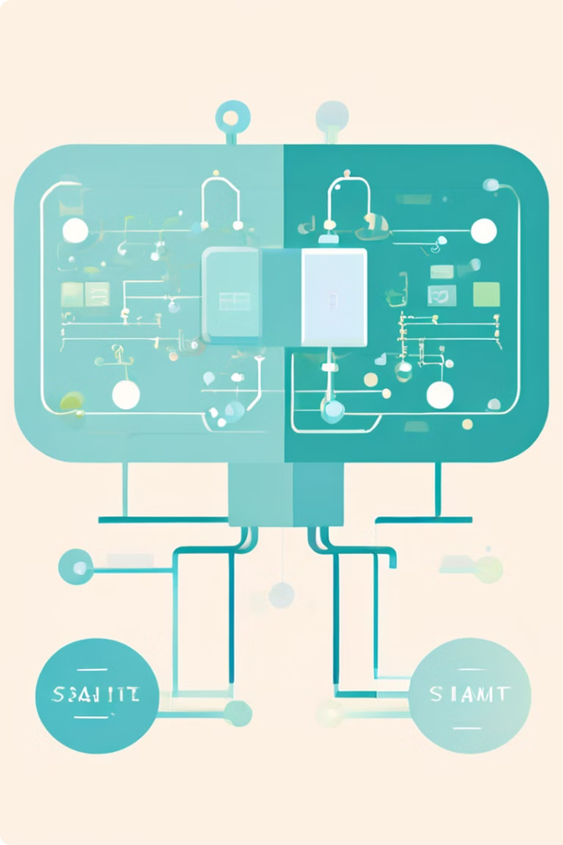
Long Short-Term Memory (LSTM) Networks
LSTMs are a type of recurrent neural network specifically designed for handling sequential data. They use internal memory cells to store information about past events.
1
Input Gate
Determines which new information is allowed into the memory cell.
2
Forget Gate
Controls which information is discarded from the memory cell.
3
Output Gate
Decides what information from the memory cell is used for generating the output.

Slide 5

Transformer Architecture and Key Components
Transformers are a revolutionary architecture that excels at processing sequential data, especially in natural language processing.
Encoder
Processes the input sequence to generate contextual representations.
Decoder
Generates the output sequence based on the encoded representations.
Attention Mechanism
Allows the model to focus on relevant parts of the input sequence.

Slide 6
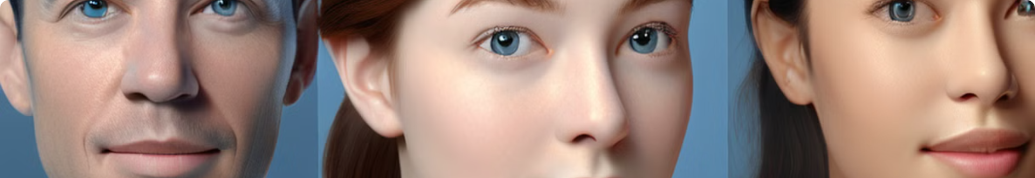



GAN Training and Applications
GANs are trained through a competitive process, where the generator and discriminator learn from each other.
Generator Training
Discriminator Training
Iteration
The generator tries to produce fake data that fools the discriminator.
The discriminator learns to distinguish between real and fake data.
Both networks continue to improve through repeated iterations, leading to better generation capabilities.

Slide 7




VAE Principles and Latent Representations
The latent space in VAEs provides a compressed representation of the data, capturing the underlying structure and variability.
Manifold Learning
Data Clustering
Data Interpolation
VAEs learn a low-dimensional manifold that captures the data distribution.
Similar data points are grouped together in the latent space, revealing hidden relationships.
New data points can be generated by interpolating between existing points in the latent space.

Slide 8
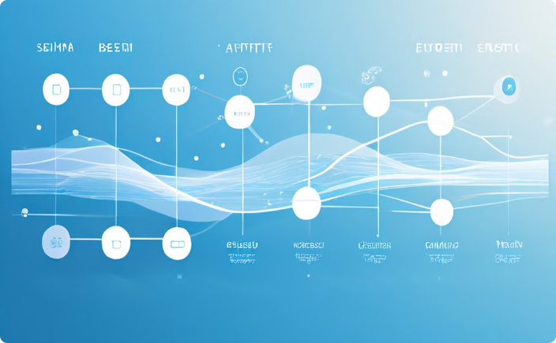

LSTM for Sequence Modeling and Generation
LSTMs are widely used in sequence modeling tasks, such as text generation, speech recognition, and machine translation.
Sequence Modeling
Text Generation
LSTMs capture temporal dependencies in sequential data to understand the context of each element.
LSTMs can be trained to generate new sequences that are similar to the training data.

